Slide 1
Module 4 - Widgets & Basic Screens

Slide 2
Contents
Introduction: Everything is a Widget
Core Widgets (Text, Image, Icon, Card, ListTile)
Input Widgets (Slider, Switch, Radio, Pickers)
Layout Basics (Column, Row, ListView, Padding)
App Structure (Scaffold, Theme, Navigation)
Design Polish (Spacing, Consistency)
Common Errors & Fixes
Practice Task & Summary

Slide 3
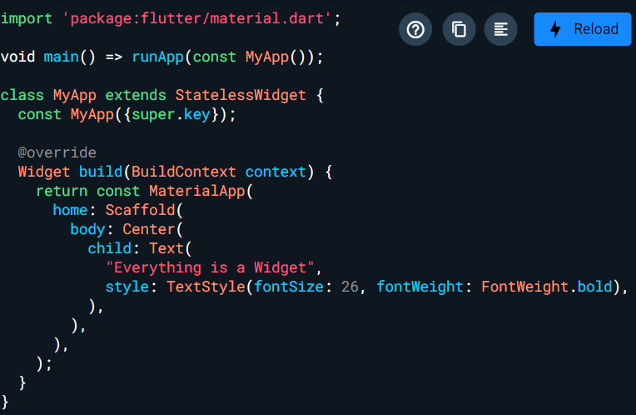
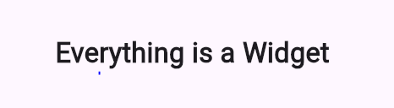
Everything is a Widget
Example run with Dartpab
In Flutter, the UI is built by composing widgets.
Widgets describe structure (layout), appearance (style), and behavior (interaction).
Every screen, every button, every text = widget
Output Preview:
Notes:
Understanding widgets helps you break UI into pieces like LEGO blocks and reuse them.
Emphasize widget = “building block”
Compare to: HTML tags / React components
Ask class: “What UI elements in this screen could be widgets?”

Slide 4
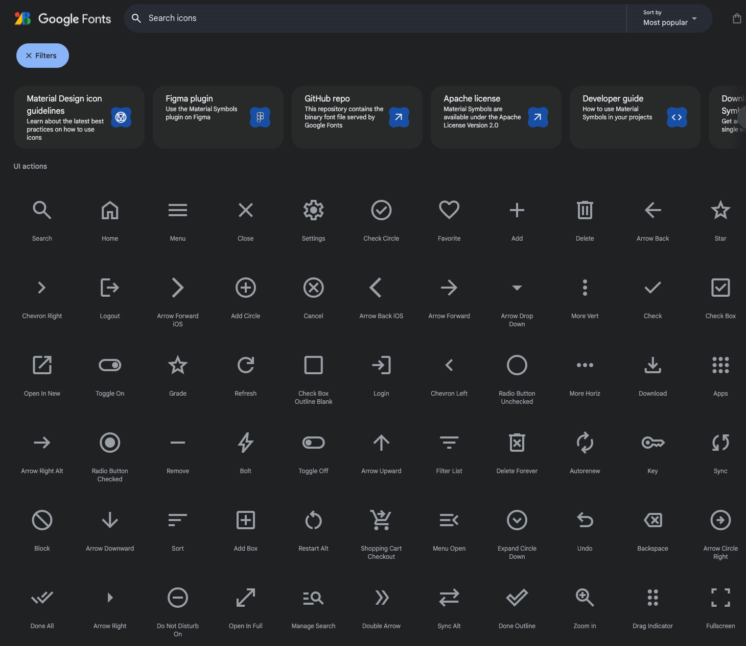
Material Icons
Icons in Flutter come from Material Design Icons library. They give consistent UI across devices.
When to use
Navigation buttons
Action buttons (add, delete)
Status indicators

Slide 5
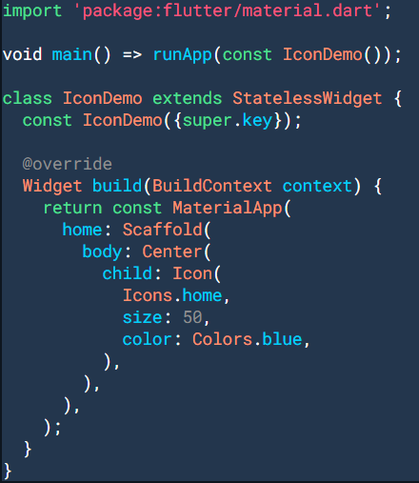

Example Material Icons
Example: Test in DartPad: https://dartpad.dev/?id=icon-widget
Output →
Notes:
Demo changing size/color quickly → instant feedback
Encourage students: replace icons in sample app

Slide 6
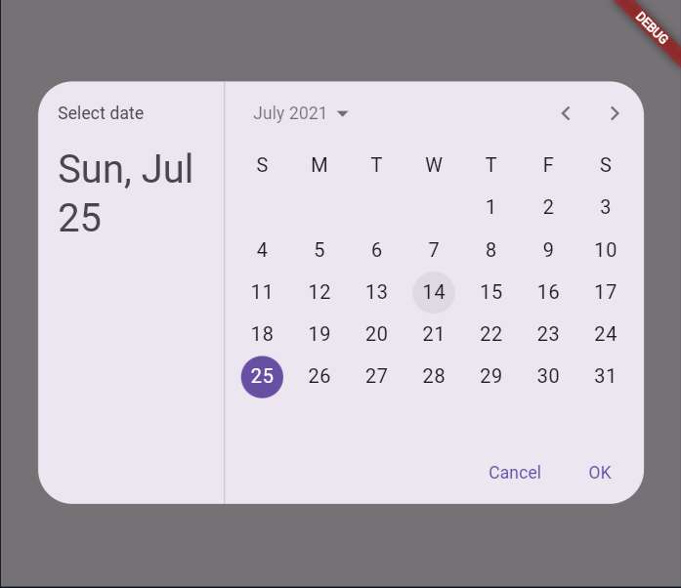
DatePicker
Material date picker allows users to select a date from a calendar UI
Real uses
Booking apps
Calendar tasks
Form inputs (date of birth, appointment)
Figure 4.2: DatePicker

Slide 7
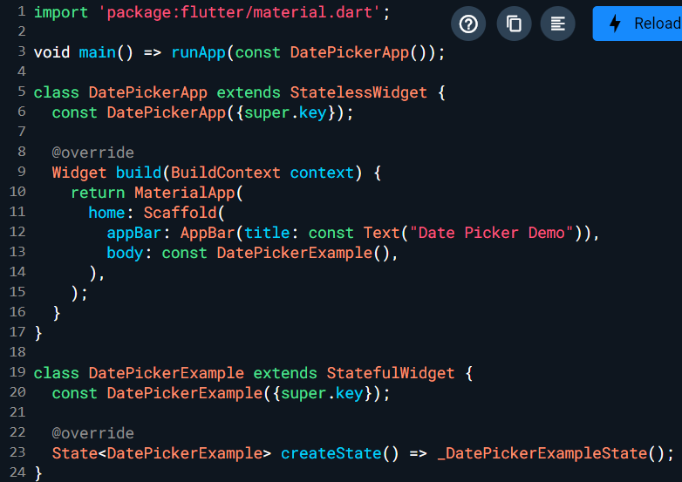
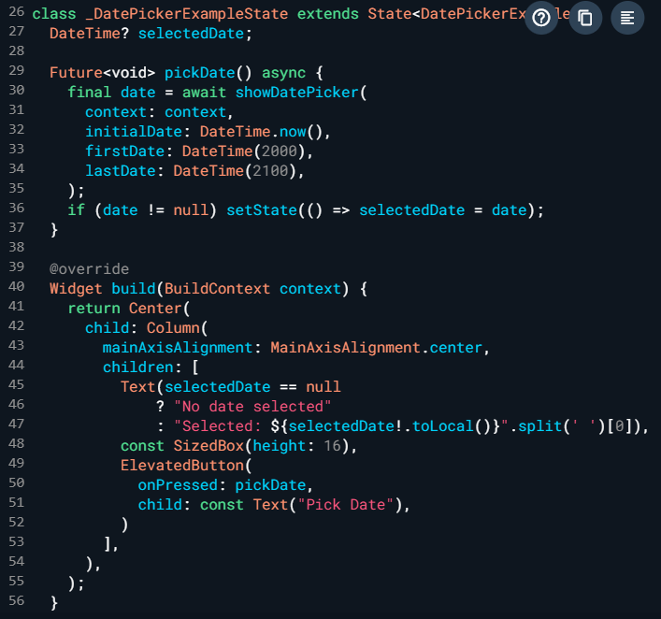
Code Example DatePicker
Notes:
import 'package:flutter/material.dart';
void main() => runApp(const DatePickerApp());
class DatePickerApp extends StatelessWidget {
const DatePickerApp({super.key});
@override
Widget build(BuildContext context) {
return MaterialApp(
home: Scaffold(
appBar: AppBar(title: const Text("Date Picker Demo")),
body: const DatePickerExample(),
),
);
}
}
class DatePickerExample extends StatefulWidget {
const DatePickerExample({super.key});
@override
State<DatePickerExample> createState() => _DatePickerExampleState();
}
class _DatePickerExampleState extends State<DatePickerExample> {
DateTime? selectedDate;
Future<void> pickDate() async {
final date = await showDatePicker(
context: context,
initialDate: DateTime.now(),
firstDate: DateTime(2000),
lastDate: DateTime(2100),
);
if (date != null) setState(() => selectedDate = date);
}
@override
Widget build(BuildContext context) {
return Center(
child: Column(
mainAxisAlignment: MainAxisAlignment.center,
children: [
Text(selectedDate == null
? "No date selected"
: "Selected: ${selectedDate!.toLocal()}".split(' ')[0]),
const SizedBox(height: 16),
ElevatedButton(
onPressed: pickDate,
child: const Text("Pick Date"),
)
],
),
);
}
}

Slide 8
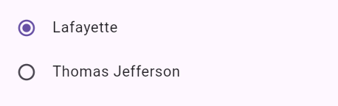
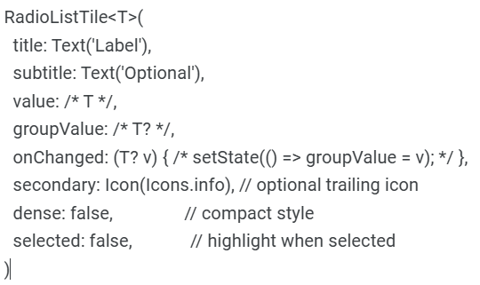
RadioListTile (Single Choice)
RadioListTile lets users pick one option from a group.
Structure (template)
Notes:
Use: Settings menus, video quality selection, filters.
Code demo
import 'package:flutter/material.dart';
void main() => runApp(const RadioDemoApp());
class RadioDemoApp extends StatelessWidget {
const RadioDemoApp({super.key});
@override
Widget build(BuildContext context) => const MaterialApp(home: RadioScreen());
}
class RadioScreen extends StatefulWidget {
const RadioScreen({super.key});
@override State<RadioScreen> createState() => _RadioScreenState();
}
class _RadioScreenState extends State<RadioScreen> {
String? quality = 'HD';
@override
Widget build(BuildContext context) {
return Scaffold(
appBar: AppBar(title: const Text('RadioListTile')),
body: Column(
children: [
RadioListTile<String>(
title: const Text('SD'),
value: 'SD',
groupValue: quality,
onChanged: (v) => setState(() => quality = v),
),
RadioListTile<String>(
title: const Text('HD'),
value: 'HD',
groupValue: quality,
onChanged: (v) => setState(() => quality = v),
),
RadioListTile<String>(
title: const Text('4K'),
value: '4K',
groupValue: quality,
onChanged: (v) => setState(() => quality = v),
),
],
),
);
}
}

Slide 9
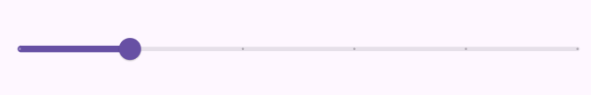
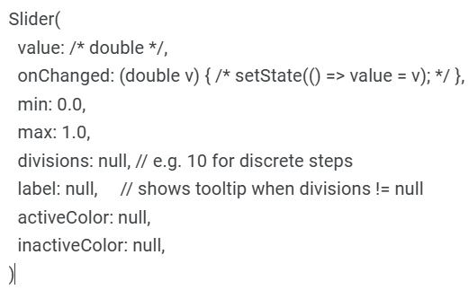
Slider (Continuous Value)
Slider allows users to adjust a value continuously between a range.
Structure (template) →
Notes:
Common props
value, min, max
onChanged / onChangeStart / onChangeEnd
divisions, label
activeColor, inactiveColor
Code demo
import 'package:flutter/material.dart';
void main() => runApp(const SliderDemoApp());
class SliderDemoApp extends StatelessWidget {
const SliderDemoApp({super.key});
@override
Widget build(BuildContext context) => const MaterialApp(home: SliderScreen());
}
class SliderScreen extends StatefulWidget {
const SliderScreen({super.key});
@override State<SliderScreen> createState() => _SliderScreenState();
}
class _SliderScreenState extends State<SliderScreen> {
double value = 0.5; // Range: 0..1
@override
Widget build(BuildContext context) {
return Scaffold(
appBar: AppBar(title: const Text('Slider')),
body: Column(
mainAxisAlignment: MainAxisAlignment.center,
children: [
Slider(
value: value,
onChanged: (v) => setState(() => value = v),
),
Text('Value: ${value.toStringAsFixed(2)}'),
],
),
);
}
}

Slide 10
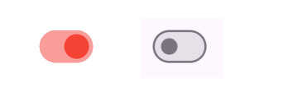
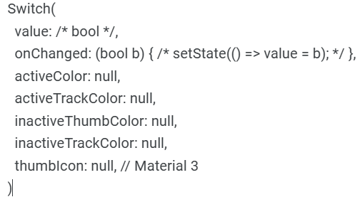
Switch (Boolean Toggle)
Switch toggles a boolean value (ON/OFF).
Use: Enable notifications, dark mode, or toggling options.
Structure (template)
Notes:
Code demo
import 'package:flutter/material.dart';
void main() => runApp(const SwitchDemoApp());
class SwitchDemoApp extends StatelessWidget {
const SwitchDemoApp({super.key});
@override
Widget build(BuildContext context) => const MaterialApp(home: SwitchScreen());
}
class SwitchScreen extends StatefulWidget {
const SwitchScreen({super.key});
@override State<SwitchScreen> createState() => _SwitchScreenState();
}
class _SwitchScreenState extends State<SwitchScreen> {
bool isOn = false;
@override
Widget build(BuildContext context) {
return Scaffold(
appBar: AppBar(title: const Text('Switch Example')),
body: Center(
child: Row(
mainAxisSize: MainAxisSize.min,
children: [
const Text('Dark Mode'),
Switch(value: isOn, onChanged: (v) => setState(() => isOn = v)),
],
),
),
);
}
}

Slide 11
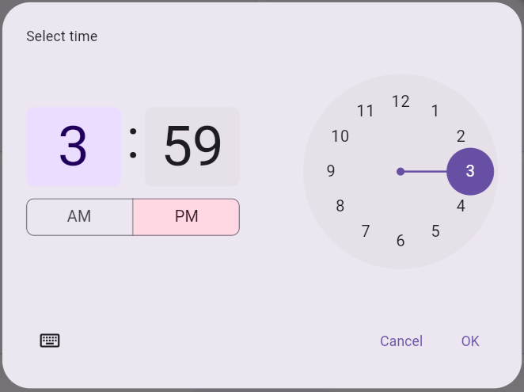
TimePicker (dialog)
Concept: show TimePicker opens a Material-style time selection dialog.
Use: Appointment scheduling, alarms, or showtime selection.
Notes:
Code demo
import 'package:flutter/material.dart';
void main() => runApp(const TimePickerDemoApp());
class TimePickerDemoApp extends StatelessWidget {
const TimePickerDemoApp({super.key});
@override
Widget build(BuildContext context) => MaterialApp(
home: Scaffold(
appBar: AppBar(title: const Text('Time Picker')),
body: const TimePickerDemo(),
),
);
}
class TimePickerDemo extends StatefulWidget {
const TimePickerDemo({super.key});
@override State<TimePickerDemo> createState() => _TimePickerDemoState();
}
class _TimePickerDemoState extends State<TimePickerDemo> {
TimeOfDay? selected;
Future<void> pick() async {
final t = await showTimePicker(context: context, initialTime: TimeOfDay.now());
if (t != null) setState(() => selected = t);
}
@override
Widget build(BuildContext context) {
final text = selected == null ? 'No time' : 'Selected: ${selected!.format(context)}';
return Center(
child: Column(mainAxisAlignment: MainAxisAlignment.center, children: [
Text(text, style: const TextStyle(fontSize: 18)),
const SizedBox(height: 12),
ElevatedButton(onPressed: pick, child: const Text('Pick Time')),
]),
);
}
}

Slide 12
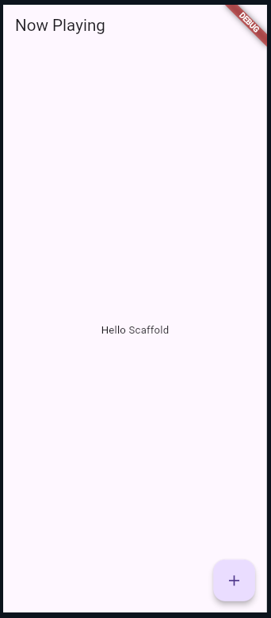
Scaffold (First Screen)
Concept: Scaffold is the backbone of a Material screen.
It provides AppBar, Body, FloatingActionButton, and other structural elements.
Use: Every major screen in your app.
Notes:
Code demo
import 'package:flutter/material.dart';
void main() => runApp(const ScaffoldDemoApp());
class ScaffoldDemoApp extends StatelessWidget {
const ScaffoldDemoApp({super.key});
@override
Widget build(BuildContext context) => const MaterialApp(home: FirstScreen());
}
class FirstScreen extends StatelessWidget {
const FirstScreen({super.key});
@override
Widget build(BuildContext context) {
return Scaffold(
appBar: AppBar(title: const Text('Now Playing')),
body: const Center(child: Text('Hello Scaffold')),
floatingActionButton: FloatingActionButton(
onPressed: () {}, child: const Icon(Icons.add),
),
);
}
}

Slide 13
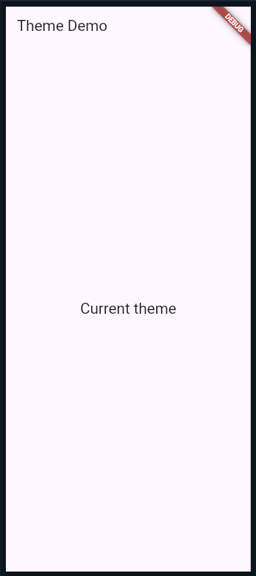
Theme & Dark Mode
Concept: ThemeData defines global color, typography, and shapes across your app.
Use: darkTheme and themeMode to switch between modes.
Notes:
Code demo
import 'package:flutter/material.dart';
void main() => runApp(const ThemedApp());
class ThemedApp extends StatelessWidget { const ThemedApp({super.key});
@override Widget build(BuildContext context) {
return MaterialApp(
theme: ThemeData.light(useMaterial3: true),
darkTheme: ThemeData.dark(useMaterial3: true),
themeMode: ThemeMode.system, // Try ThemeMode.dark to preview
home: const DemoTheme(),
);
}}
class DemoTheme extends StatelessWidget { const DemoTheme({super.key});
@override Widget build(BuildContext context) {
return Scaffold(
appBar: AppBar(title: const Text('Theme Demo')),
body: Center(
child: Text('Current theme',
style: Theme.of(context).textTheme.titleLarge),
),
);
}
}

Slide 14
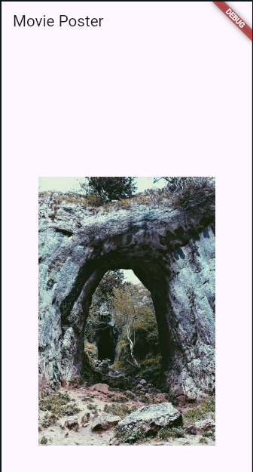
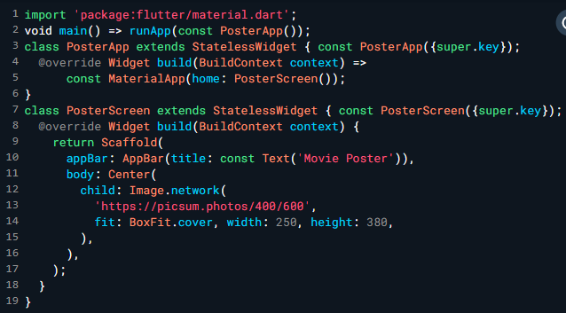
Image (Poster Detail)
Concept: Image.network or Image.asset displays pictures with scaling via BoxFit.
Use Case: Used for posters, banners, or product images.
Notes:
Notes
macOS users need Xcode for iOS builds.
Windows users should enable virtualization for emulator support.

Slide 15
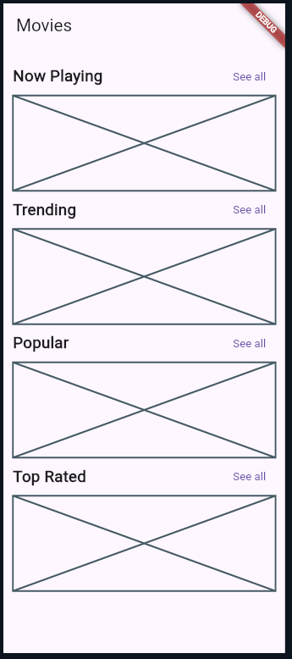
Sectioned Home Screen (Layout)
Concept: Column, Padding, and ListView build vertical UI sections.
Common in movie, product, or news apps.
Notes:
Code demo
import 'package:flutter/material.dart';
void main() => runApp(const SectionsApp());
class SectionsApp extends StatelessWidget { const SectionsApp({super.key});
@override Widget build(BuildContext context) =>
const MaterialApp(home: SectionsHome());
}
class SectionsHome extends StatelessWidget { const SectionsHome({super.key});
Widget section(String title) => Padding(
padding: const EdgeInsets.symmetric(vertical: 8),
child: Row(
mainAxisAlignment: MainAxisAlignment.spaceBetween,
children: [
Text(title, style: const TextStyle(fontSize: 20, fontWeight: FontWeight.bold)),
TextButton(onPressed: (){}, child: const Text('See all')),
],
),
);
@override Widget build(BuildContext context) {
return Scaffold(
appBar: AppBar(title: const Text('Movies')),
body: ListView(
padding: const EdgeInsets.all(12),
children: [
section('Now Playing'), const Placeholder(fallbackHeight: 120),
section('Trending'), const Placeholder(fallbackHeight: 120),
section('Popular'), const Placeholder(fallbackHeight: 120),
section('Top Rated'), const Placeholder(fallbackHeight: 120),
],
),
);
}
}

Slide 16
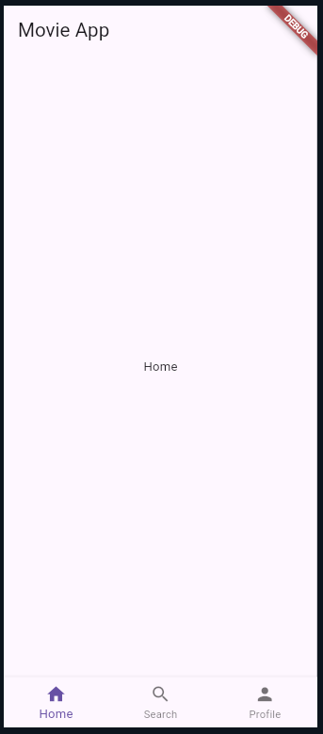
Bottom Navigation Bar
Concept: Displays 2–5 navigation tabs at the bottom.
Used for quick switching between app views.
Notes:
Code demo
import 'package:flutter/material.dart';
void main() => runApp(const NavApp());
class NavApp extends StatelessWidget { const NavApp({super.key});
@override Widget build(BuildContext context) =>
const MaterialApp(home: HomeTabs());
}
class HomeTabs extends StatefulWidget { const HomeTabs({super.key});
@override State<HomeTabs> createState() => _HomeTabsState();
}
class _HomeTabsState extends State<HomeTabs> {
int index = 0;
final screens = const [
Center(child: Text('Home')),
Center(child: Text('Search')),
Center(child: Text('Profile')),
];
@override Widget build(BuildContext context) {
return Scaffold(
appBar: AppBar(title: const Text('Movie App')),
body: screens[index],
bottomNavigationBar: BottomNavigationBar(
currentIndex: index,
onTap: (i) => setState(()=> index = i),
items: const [
BottomNavigationBarItem(icon: Icon(Icons.home), label: 'Home'),
BottomNavigationBarItem(icon: Icon(Icons.search), label: 'Search'),
BottomNavigationBarItem(icon: Icon(Icons.person), label: 'Profile'),
],
),
);
}
}

Slide 17
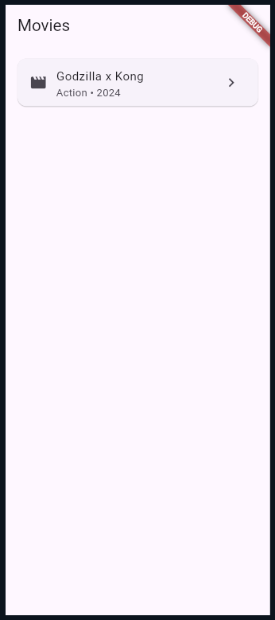
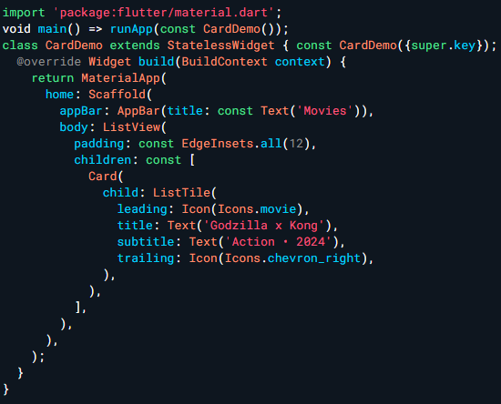
Card + ListTile
Card + ListTile = material pattern for displaying concise information.

Slide 18
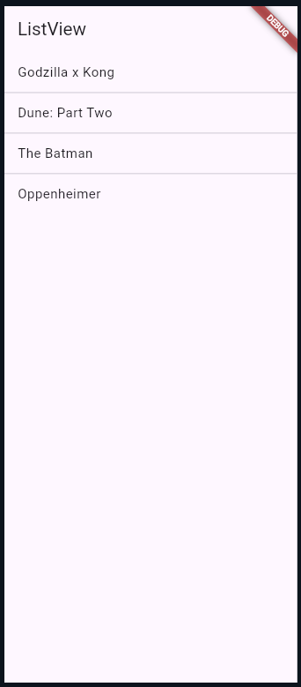
ListView Basics (Movie Titles)
ListView creates a scrollable column; use separated or builder for long lists.
Use Case: Movie titles, product names, chat items.
Notes:
Code demo
import 'package:flutter/material.dart';
void main() => runApp(const ListApp());
class ListApp extends StatelessWidget {
const ListApp({super.key});
@override
Widget build(BuildContext context) =>
const MaterialApp(home: Titles());
}
class Titles extends StatelessWidget {
const Titles({super.key});
@override
Widget build(BuildContext context) {
final items = const ['Godzilla x Kong','Dune: Part Two','The Batman','Oppenheimer'];
return Scaffold(
appBar: AppBar(title: const Text('ListView')),
body: ListView.separated(
itemCount: items.length,
separatorBuilder: (_, __) => const Divider(height: 1),
itemBuilder: (_, i) => ListTile(title: Text(items[i])),
),
);
}
}

Slide 19
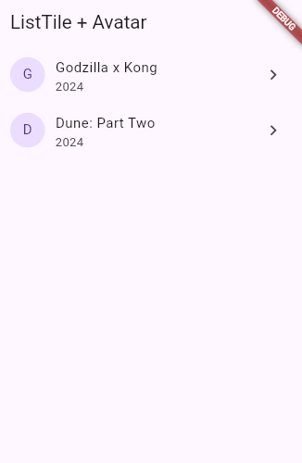
ListTile + CircleAvatar Widgets
Concept: ListTile provides a standard row layout; CircleAvatar gives a modern leading visual.
Use Case: Contact list, movie list, product list.
Notes:
Code demo
import 'package:flutter/material.dart';
void main() => runApp(const TileApp());
class TileApp extends StatelessWidget {
const TileApp({super.key});
@override
Widget build(BuildContext context) =>
const MaterialApp(home: TileList());
}
class TileList extends StatelessWidget {
const TileList({super.key});
@override
Widget build(BuildContext context) {
final movies = const [
{'title':'Godzilla x Kong','year':'2024'},
{'title':'Dune: Part Two','year':'2024'},
];
return Scaffold(
appBar: AppBar(title: const Text('ListTile + Avatar')),
body: ListView.builder(
itemCount: movies.length,
itemBuilder: (_, i) {
final m = movies[i];
return ListTile(
leading: CircleAvatar(child: Text(m['title']![0])),
title: Text(m['title']!), subtitle: Text(m['year']!),
trailing: const Icon(Icons.chevron_right),
onTap: () => debugPrint('Selected ${m['title']}'),
);
},
),
);
}
}

Slide 20
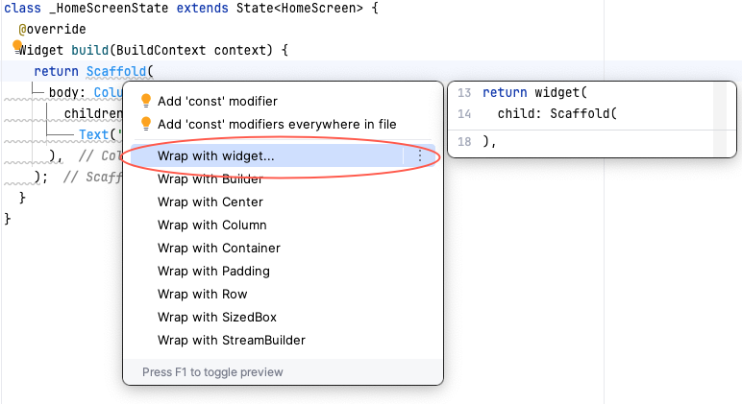
VS Code “Wrap with Widget”
Editor-assisted refactor: wrap any widget with Padding, Center, Expanded, etc.
Use Case: Speed up layout composition; enforce consistent spacing.
Notes:
Advantages
Fast startup & low memory usage
Easy extensions management
Integrated terminal

Slide 21
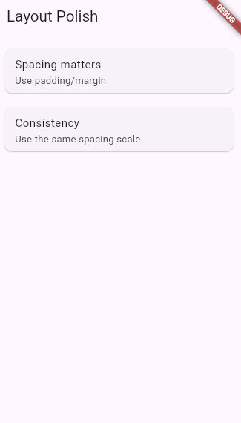
Layout Polish (Padding & SizedBox)
Concept: Good spacing improves readability and perceived quality.
Use Case: Apply consistent spacing scale across the app.
Notes:
Code demo
import 'package:flutter/material.dart';
void main() => runApp(const PolishApp());
class PolishApp extends StatelessWidget {
const PolishApp({super.key});
@override
Widget build(BuildContext context) =>
const MaterialApp(home: Polish());
}
class Polish extends StatelessWidget {
const Polish({super.key});
Widget tile(String t, String s) => Card(
margin: const EdgeInsets.symmetric(vertical: 6),
child: ListTile(title: Text(t), subtitle: Text(s)),
);
@override
Widget build(BuildContext context) {
return Scaffold(
appBar: AppBar(title: const Text('Layout Polish')),
body: Padding(
padding: const EdgeInsets.all(12),
child: Column(
children: [
tile('Spacing matters', 'Use padding/margin'),
const SizedBox(height: 8),
tile('Consistency', 'Use the same spacing scale'),
],
),
),
);
}
}

Slide 22
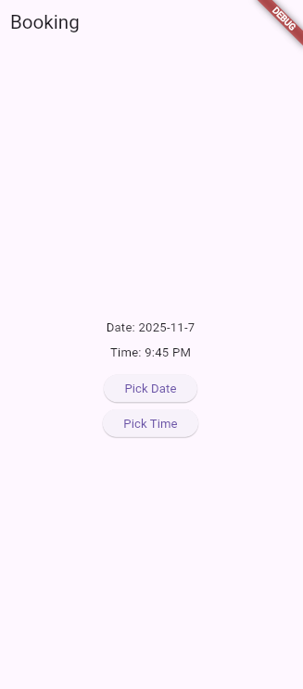
Date & Time Pickers (Combined)
Concept Use both pickers to build booking workflows.
Use Case Movie ticket booking: select both date and time
Notes:
import 'package:flutter/material.dart';
void main() => runApp(const BookingApp());
class BookingApp extends StatelessWidget {
const BookingApp({super.key});
@override
Widget build(BuildContext context) =>
const MaterialApp(home: Booking());
}
class Booking extends StatefulWidget {
const Booking({super.key});
@override State<Booking> createState() => _BookingState();
}
class _BookingState extends State<Booking> {
DateTime? d; TimeOfDay? t;
Future<void> pickDate() async {
final x = await showDatePicker(
context: context, initialDate: DateTime.now(),
firstDate: DateTime(2020), lastDate: DateTime(2100));
if (x != null) setState(()=> d = x);
}
Future<void> pickTime() async {
final x = await showTimePicker(
context: context, initialTime: TimeOfDay.now());
if (x != null) setState(()=> t = x);
}
@override
Widget build(BuildContext context) {
final dateText = d == null ? 'No date' : '${d!.year}-${d!.month}-${d!.day}';
final timeText = t == null ? 'No time' : t!.format(context);
return Scaffold(
appBar: AppBar(title: const Text('Booking')),
body: Center(child: Column(
mainAxisAlignment: MainAxisAlignment.center,
children: [
Text('Date: $dateText'), const SizedBox(height: 8),
Text('Time: $timeText'), const SizedBox(height: 16),
ElevatedButton(onPressed: pickDate, child: const Text('Pick Date')),
const SizedBox(height: 8),
ElevatedButton(onPressed: pickTime, child: const Text('Pick Time')),
],
)),
);
}
}

Slide 23
Common Errors & Fixes
Typical issues when building basic UI.
Checklist
ListView inside Column → wrap with Expanded
Overflow on small screens → use Flexible / SingleChildScrollView
UI not updating → forgot setState()
Picker call fails → make sure you call with a valid BuildContext

Slide 24
Practice Task
Task
Build a movie list: title, year
Use ListView.builder + ListTile
onTap → show SnackBar(title)
Bonus: replace avatar with an emoji or poster image

Slide 25
Summary
You Learned:
The “Everything is a Widget” concept in Flutter
Building screens using Scaffold, AppBar, and Body
Using core widgets: Image, Card, ListTile, ListView
Managing interactivity with Switch, Slider, RadioListTile, and Pickers
Applying ThemeData and handling Dark Mode
Improving design with Padding, SizedBox, and consistent spacing
Identifying and fixing common layout errors

Slide 26
References
Mastering Flutter 2025 – Ch.4
docs.flutter.dev
https://dartpad.dev

